Slide 1
IR 634 Information Retrieval Final project
Sainath Dutkar
Aqsa Sheikh
Istabraq almusally

Slide 2
Table of contents
Introduction
Spelling Corrector
Snippet
Lucene implementation
Relevancy Judgement

Slide 3
Introduction
Project goal is to improve the Lucene performance
Implemented the Spelling Corrector
Implemented the Snippet
Indexing and Searching using Apache Lucene
Relevance judgement

Slide 4
SPELLING CORRECTOR
We have implemented the Norvig’s Spell Checker by following the candidate model.
For the dictionary of words we have used the most frequently used words from the following website
https://www.wordfrequency.info/free.asp

Slide 5
Candidate model
To find the correct replacement of the word all the possible candidate words are created from the given word
List of possible candidates is created using following methods on the given word
DELETE – Removes single letter and returns the word
TRANSPOSE – Swap the adjust letters in the word
REPLACE – Change one letter to another letter
INSERT – Add a letter to the word

Slide 6
Algorithm
Step 1 : Creating a dictionary with Words as Key and Weight as value
Step 2 : Check if the Query word is present in Dictionary => if yes return the word ELSE Step3
Step 3 : Get all Possible Edits
Edits => Get the list of possible candidate words
Step 1 : deletes (remove 1 letter)
Step 2 : Transpose (Swap adjusted letters)
Step 3 : Replace (Change one letter to another)
Step 4 : Insert (Add a letter)
Step 4 : Create a Candidate list
Step 5 : Traverse all possible edits comparing with Dictionary list and storing the matches in a Candidate MAP
Step 6 : Return the most weighted word
Step 7 : If no match is found. Run the edit function on the list of edit words once.
Step 8 : Repeat step 5 and Step 6
Step 9 : If no possible hit found => return the word

Slide 7
Few examples
WORD | CORRECTED WORD
BIE | BEE
Tonge | Tongue
Polution | Pollution
Clib | Clip
Blub | Bulb
Flowr | flour
Mayar | Mayor
Taid | aid

Slide 8
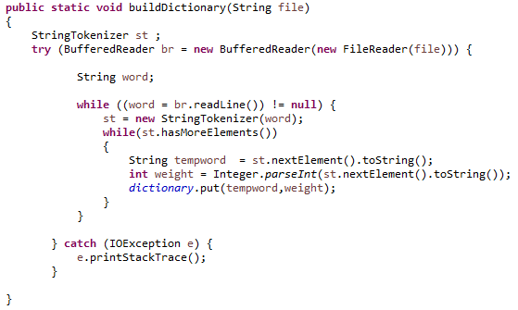
Code
To build Dictionary

Slide 9
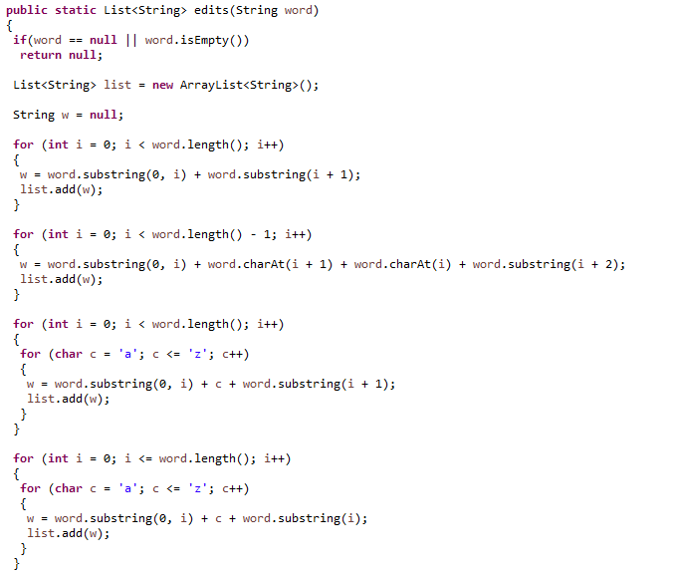
Generate Candidates

Slide 10
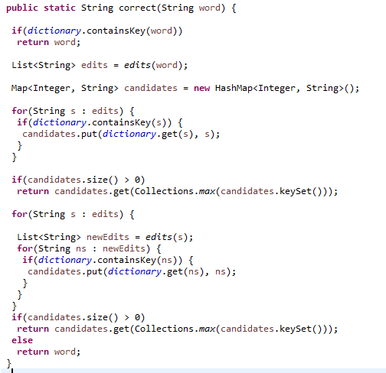
Correct function

Slide 11
SNIPPET
Generally, Snippet is 2-3 line description of the main information of a website just found below the URL on the main search page of a search engine.
We have implemented this feature to display a brief summary of the information in the document.

Slide 12
Approach
Take the document from the file
Enter the query search
Find the query and pick up the desired sentence length after the query search word
These words form the Snippet of the document.

Slide 13
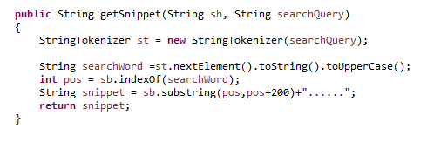
CODE

Slide 14
DATA
COLLECTION : TREC (94-2 , 94-3 , 96-4)
Number of Documents : 3338
Size : 2.56 GB
QUERY SET : SDR1-SDR50
Number of Queries : 5
Average Number of relevance Document : 25.99

Slide 15
Precision
Query set | TREC EVALAUATION | OUR CODE EVALUATION
Query 1 | 3/30 =10% | 4/30 =13.33%
Query 2 | 10/30 = 33.33% | 8/30 =26.66%
Query 3 | 10/30 =33.33% | 6/30 =20%
Query 4 | 3/30 = 10% | 7/30 =23.33%
Query 5 | 11/30 =36.66% | 14/30 =46.66%
Avg | 24.664 | 25.99

Slide 16

DEMO

Slide 17
Reference
http://www.norvig.com/spell-correct.html
https://www.wordfrequency.info/free.asp

